Slide 1
Senior Project
Sasha Lorow

Slide 2
Description
This project is dedicated to my father.
My senior project is a game environment. For this environment, I envisioned a hidden grotto with mini islands inside of it. In the center of the grotto is an aged pagoda. The pagoda has vines growing on it to show its age, but with gold roof tiles to show it’s something valuable. The red and gold colors I chose for the pagoda point to the lucky and valuable colors in Asian culture. The light sources in the environment would be from a hole on the top of the cave, paper lanterns floating all around the cave, and paper lantern boats floating on top of the water. To give it a mysterious, mystical feel, I changed the color of the light to be a shade of purple, so that it still gives the idea of being night. There will be water all inside of the grotto, but it will be moving like a calm ocean. A sign will be near the pagoda that says “You will not be forgotten” in Japanese. My idea for this environment is a place where you can remember your loved ones. It is a reminder that they are always with you, even if they are not there physically.

Slide 3
Programs Used
Autodesk Maya
Modeling
Uving/Texturing
Unity: Game Engine
Models were imported
Different assets were imported
Water, texture, lighting, etc.
Scene was rendered out of Unity

Slide 4
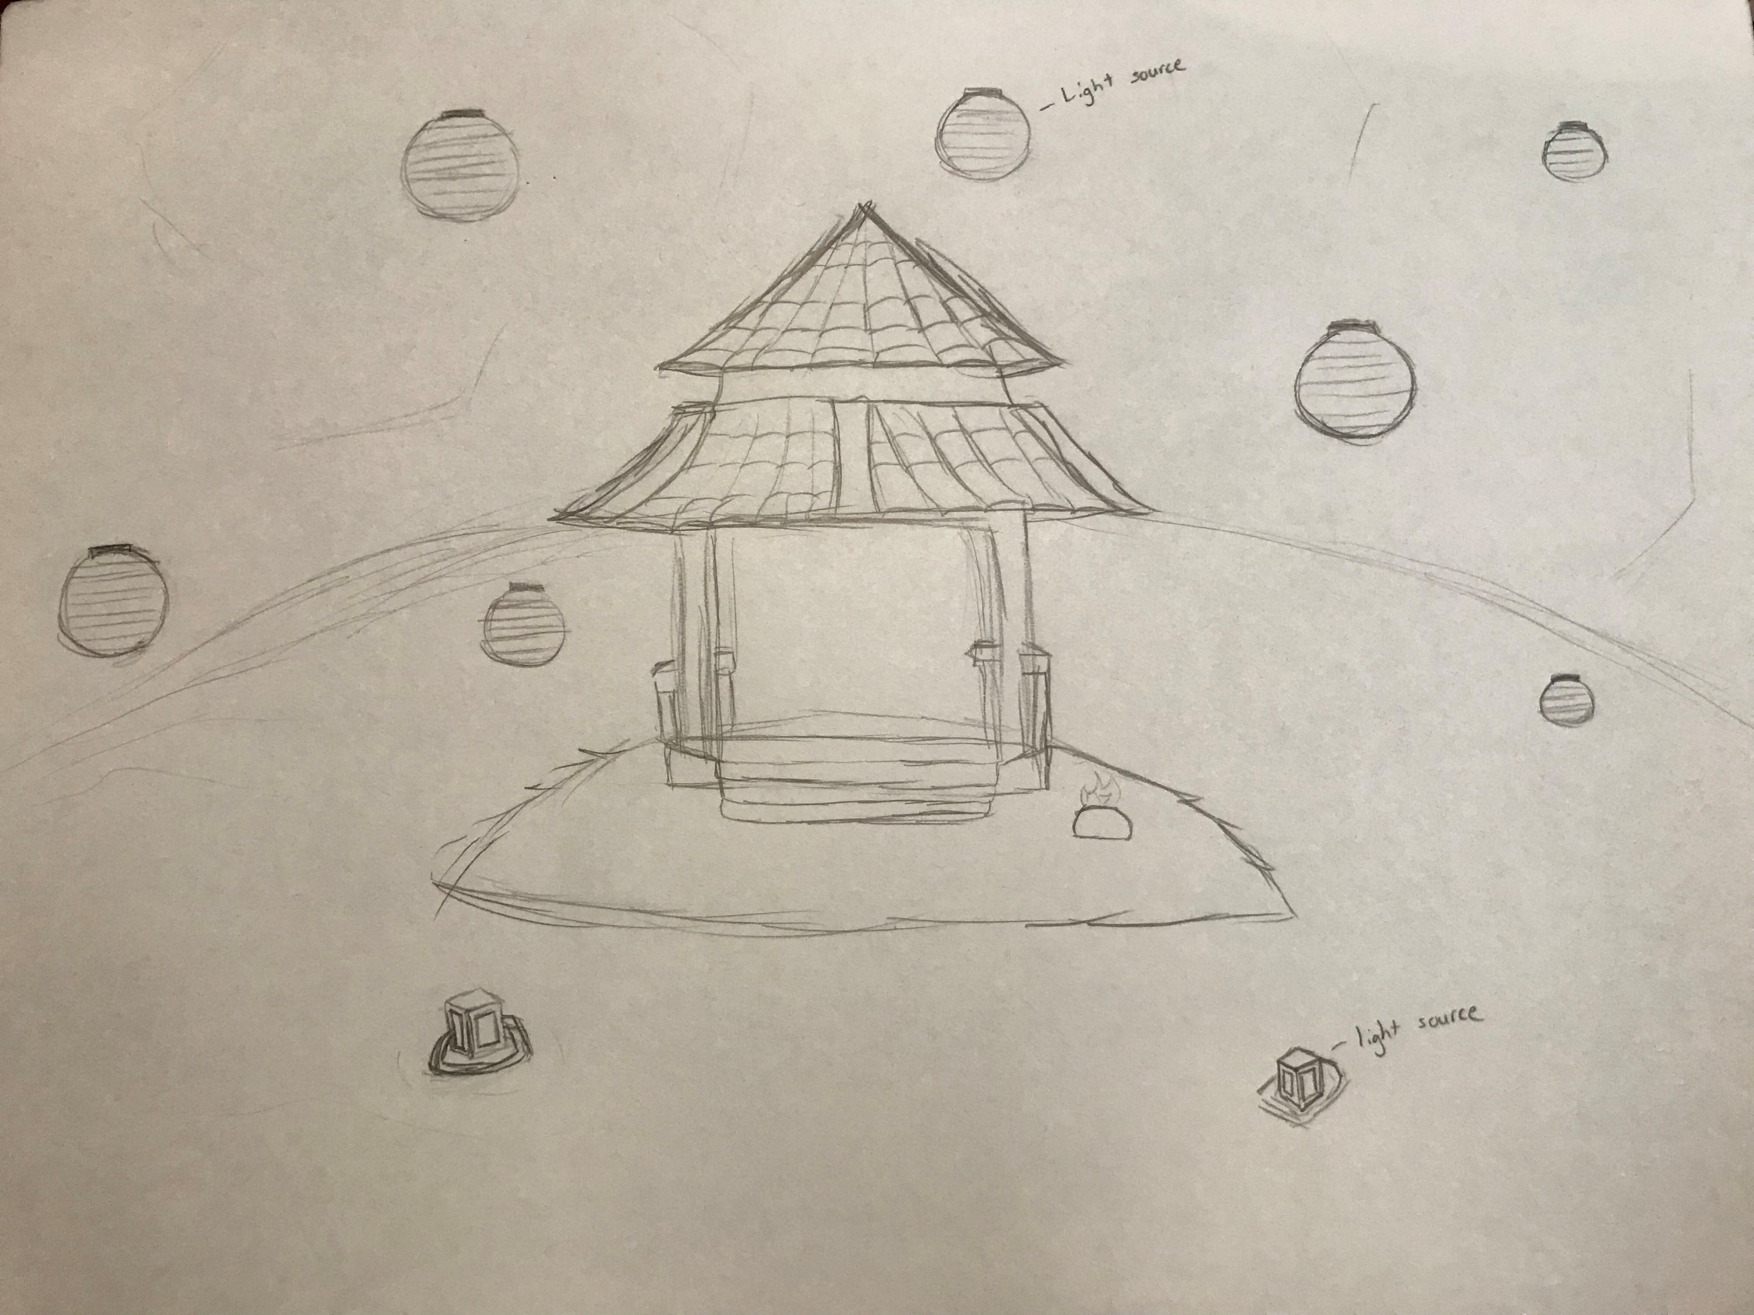
Concept Art

Slide 5
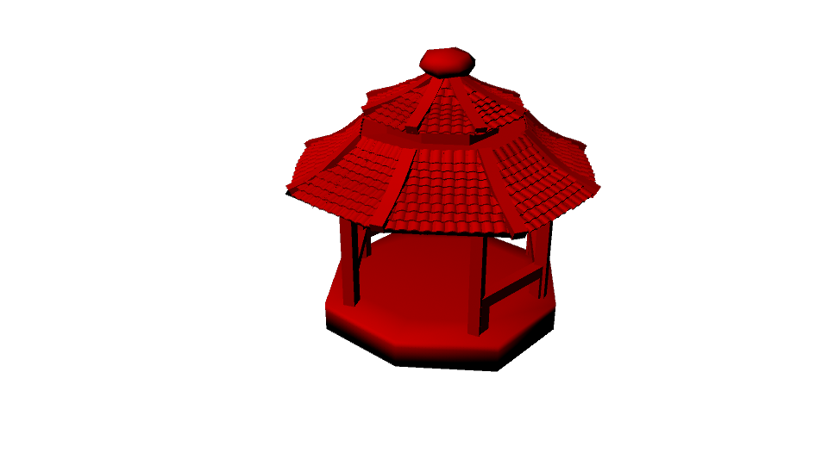
Progress Work

Slide 6
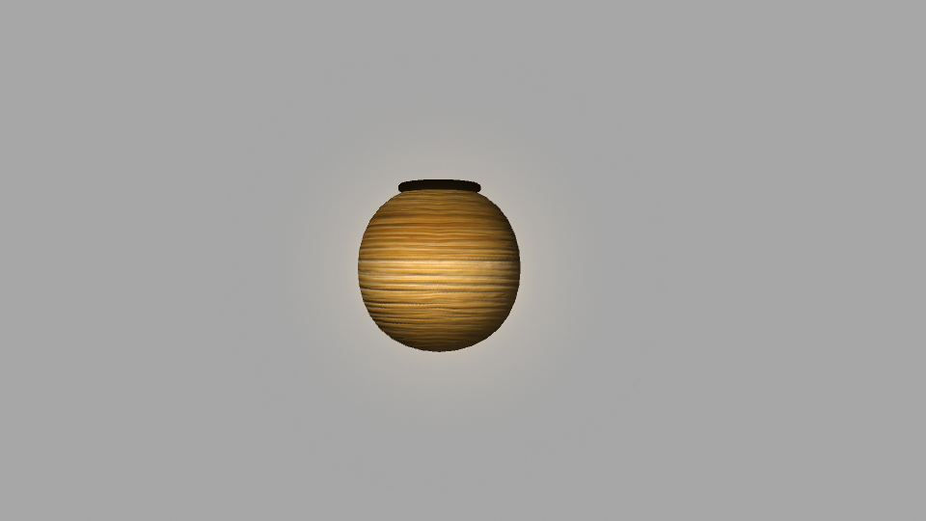
Floating lantern

Slide 7
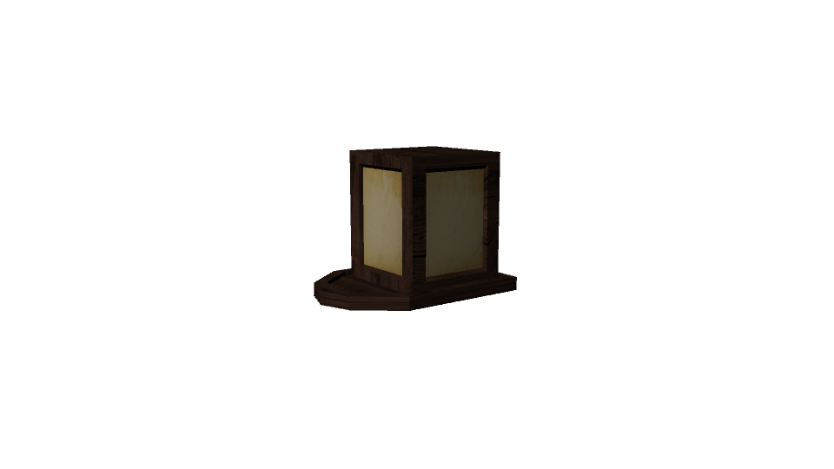
Water Lantern

Slide 8
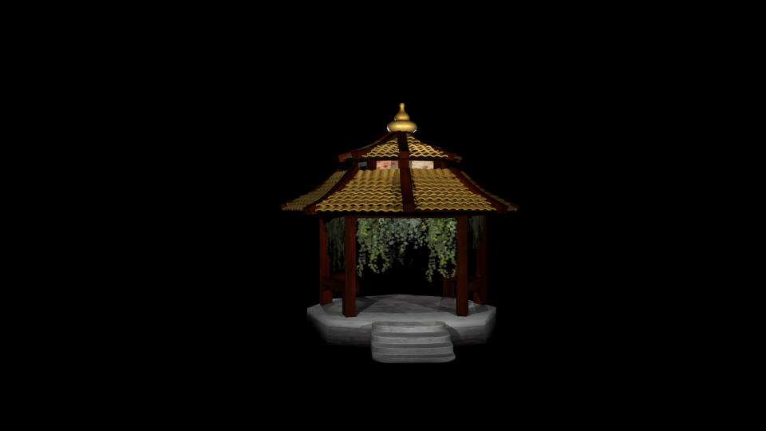
Final Render

